Slide 1
Two stage Portfolio optimisation using Ball Mapper Algorithm
Ritvik Gupta 2019MT10512
Anshuman Panda 2019MT10463
Supervisor-
Prof. Aparna Mehra

Slide 2
Introduction
In finance, portfolio construction or asset allocation is one of the most frequent problems faced by practitioners. This was first introduced by Markowitz in his Portfolio Theory
There are many biases involved when a person chooses stocks manually. Hence a more quantitative and formulaic way to choose investments is necessary
A highly utilized method to reduce risk is diversification. An automated method to classify or cluster assets would be very useful and essential to investment decision-making and the practice of diversification.
The stocks would be separated into groups via a clustering method that maximizes similarity within groups and minimizes similarity between groups.

Slide 3
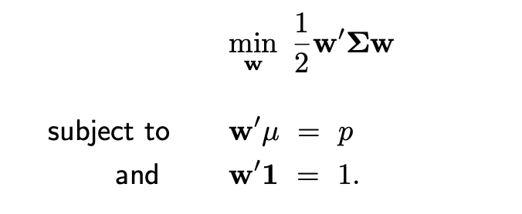
Modern Portfolio Theory
MPT is a practical method for allocating funds to assets in order to maximize their overall returns within an acceptable level of risk.
Expected Return
It is the amount of profit or loss from an asset gets on the basis of historical data of return rates.
It can be measured by average value of the returns of the asset.

Slide 4
Financial Risk
Defined as the chance that an asset’s actual gains are different from the expected rewards of the asset
Standard deviation of the gains is a common metric associated with financial risk
It is measure of the risk associated with the asset prices in comparison to their historical averages for some period of time.
There are two types of risk:
Systematic Risk: inherent to the market and affects the entire market
Idiosyncratic Risk: specific to a particular asset or a group of assets

Slide 5
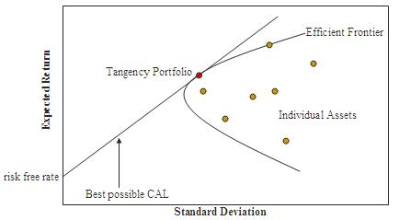
Efficient Frontier
Set of optimal portfolios that maximise returns for a given amount of risk or those portfolios with minimum risk for a given amount of expected returns.
Portfolios that lie below that efficient frontier are sub-optimal as they do not maximise the returns or minimise the risk.

Slide 6
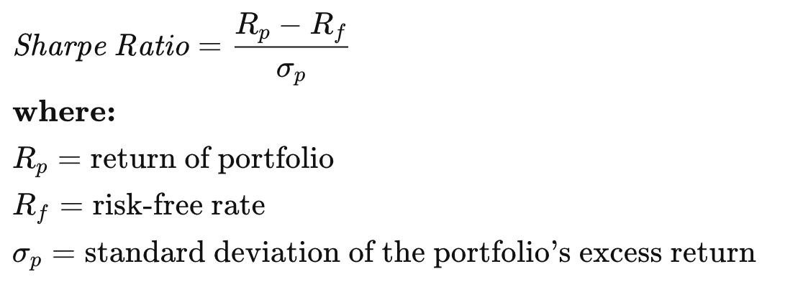
Sharpe Ratio

Slide 7
Allocating Portfolios
We have used two methods to choose portfolio allocations:
Maximise Sharpe Ratio
Minimise Volatility

Slide 8
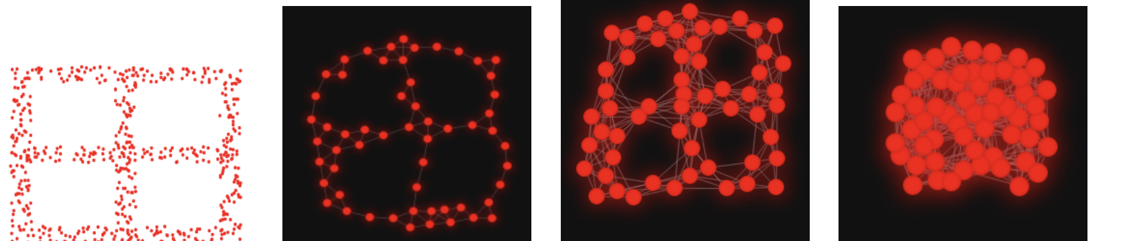
Ball Mapper Algorithm
We have used the ball mapper clustering algorithm
This algorithm takes as input a set of n-dimensional points, with associated values (labels)
Some points are designated as “landmarks” and other points that are in an epsilon neighborhood of a landmark are kept in the cluster of that landmark
It is ensured that all points are covered by at least one landmark
The idea is points that are nearby must have similar labels (which are real values)
The following figure shows an example set of points (2D), the next figure shows the associated landmarks.

Slide 9
How is Ball Mapper related to Portfolio optimisation
The aim of the project is to cluster companies in order to build a diversified portfolio
Companies with similar financial ratios (debt to assets, asset turnover, return on assets) tend to perform similar to each other, even in times of crisis
The Ball Mapper algorithm can be used to identify and cluster companies with similar values of the aforementioned ratios (these companies in an n-dimensional field represented by financial ratios will be within an epsilon neighborhood)
Investing in companies from different clusters will lead to diversified portfolio, hence minimising idiosyncratic risk

Slide 10
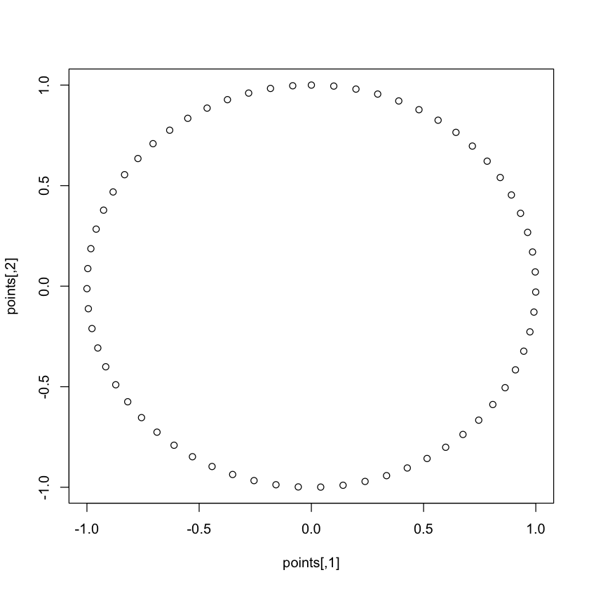
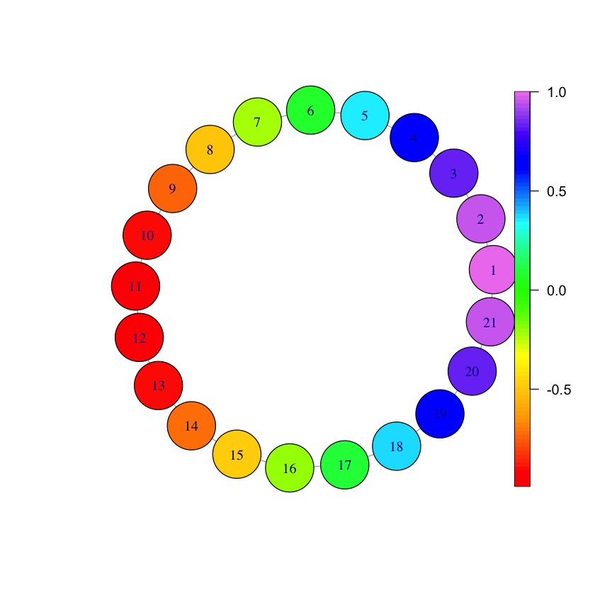

Slide 11
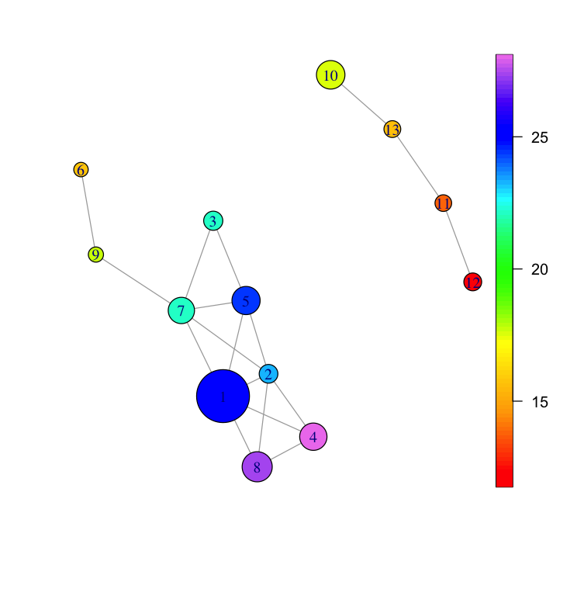
Boston Property Dataset

Slide 12
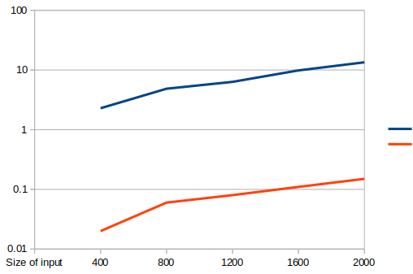
Optimization in Ball Mapper
The CRAN package of Ball Mapper has some suboptimal code blocks that were optimised:
In a part we needed to eliminate duplicate edges from the ball mapper graph, that was O(n^2) in the CRAN package and was optimised to O(nlogn)
The whole code was deployed in C++, which dramatically decreased the runtime by 100 times
CRAN Ball Mapper runtime
Optimised Ball Mapper runtime

Slide 13
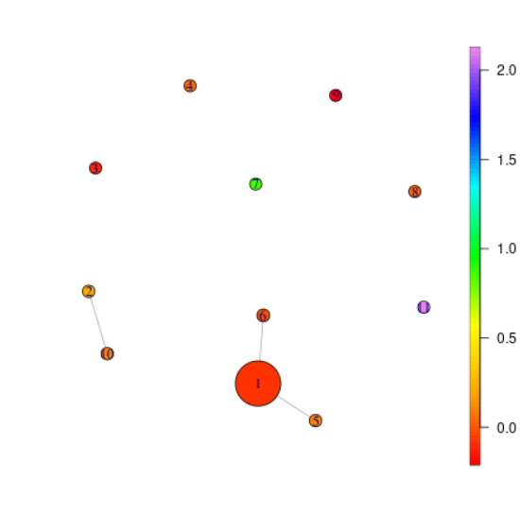
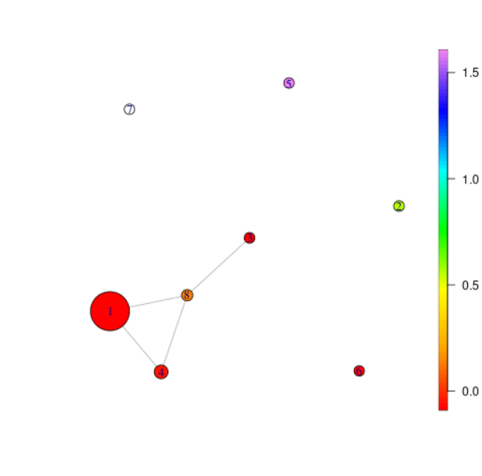
Some Results from Ball Mapper
Here we show some ball mappers produced by financial ratios as parameters
2018 q2
2019 q3

Slide 14
Related Work
Automated methods of classifying assets for the purpose of diversification are recent innovations. In 2005, Zhiwei Ren in Portfolio Construction Using Clustering Methods uses cluster analysis to group highly correlated stocks and then uses those clusters to run mean-variance (MVO) portfolio optimization.
Other approaches use measure of similarity that are related to the previous success or potential for growth of the companies like Net Income, Revenue, Assets, etc. The clusters of assets thus formed tend to be more structurally sound in times of crisis.
In the interest of having high returns and low risks, stocks are picked to maximize the return to risk ratio. The Sharpe ratio, or the average return earned in excess of the risk-free rate per unit of volatility, is a measure of calculating risk-adjusted return. Another ratio is the Omega ratio. These are used to determine the best stocks from each cluster.

Slide 15
Formulation
In this project, we have developed a two-stage portfolio optimisation:
Stage 1:
The first stage will shortlist potential assets to invest in from a list of assets indexed in a typical stock exchange like NASDAQ, NIFTY, etc.
We cluster the assets using the Ball Mapper algorithm based on input parameters like financial ratios.
For this project, we have used
the S&P 500 stocks for the list of assets.
Return on Assets and Debt to Assets ratio as parameters for clustering the data using Ball Mapper Algorithm

Slide 16
Formulation
Stage 2:
The second stage refines the choice of assets to invest in, and optimises the capital allocation to each of these assets based on MVO.
From each cluster, we pick some assets based on their Sharpe ratio and create a shortlist of assets from the 500 stocks available to us.
We then apply MVO to the shortlisted stocks to find weights for asset allocation for portfolio with the best Sharpe ratio.

Slide 17
Data used
Company financial statements:
Obtained from AlphaVantage API
Prices of S&P 500 Stocks:
Obtained from AlphaVantage API
Prices of S&P 500 Index:
Obtained from FRED

Slide 18
Evaluation
We first shortlist the stocks using financial data of S&P 500 from a quarter.
We use the company balance sheet data for Returns and Debt. In order to normalise these values on the basis of company size, we divide them by the Total assets of the company.
These values along with the stock prices for the S&P companies for this quarter are used to run our proposed method.
We then test the performance of the portfolio in comparison to the S&P Index for the following quarter by considering a portfolio of $10,000.
We create the portfolio in two ways: by maximising sharpe ratio, or by minimising volatility.

Slide 19
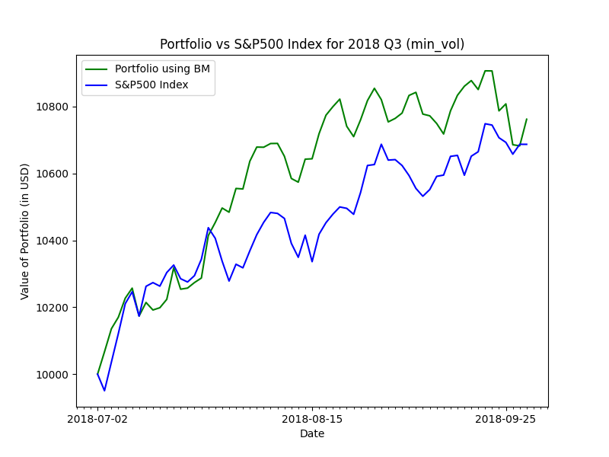
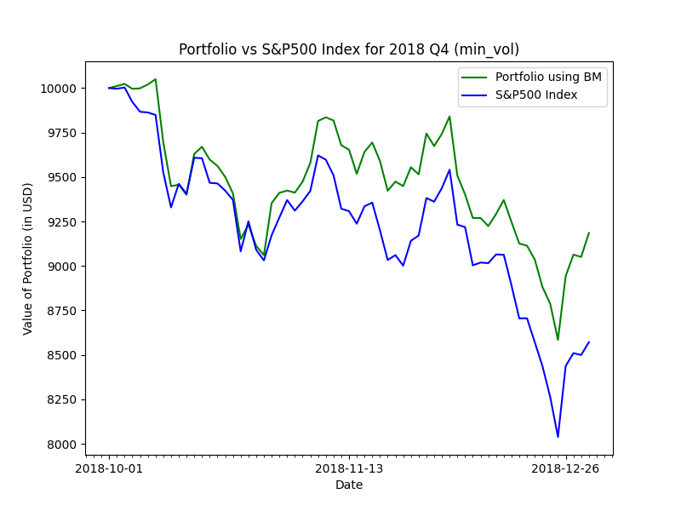
Results
In the following graphs we have plotted our portfolio values against S&P500 index values. In most of the quarters our portfolio seems to beat the index. Blue line indicates S&P500 index value and green line indicates our portfolio value. Both start from 10000$

Slide 20
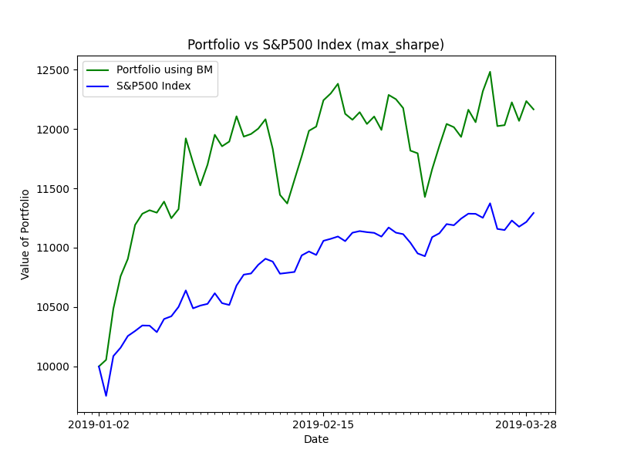
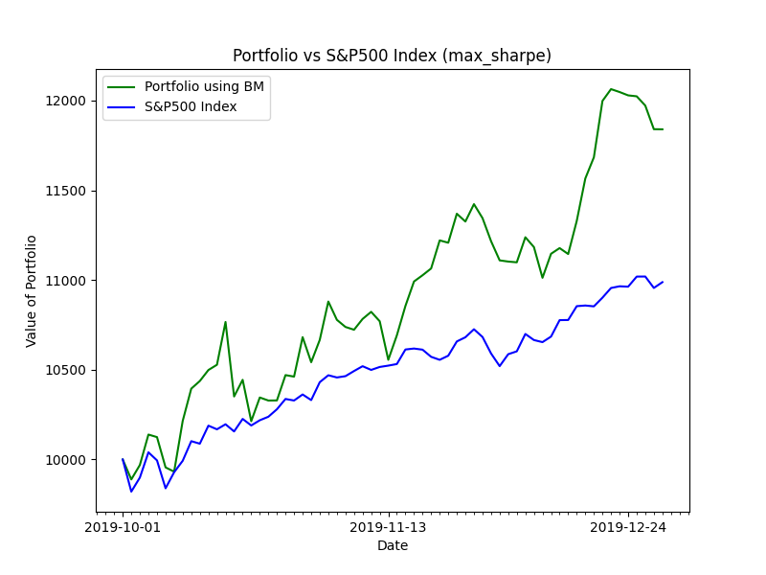
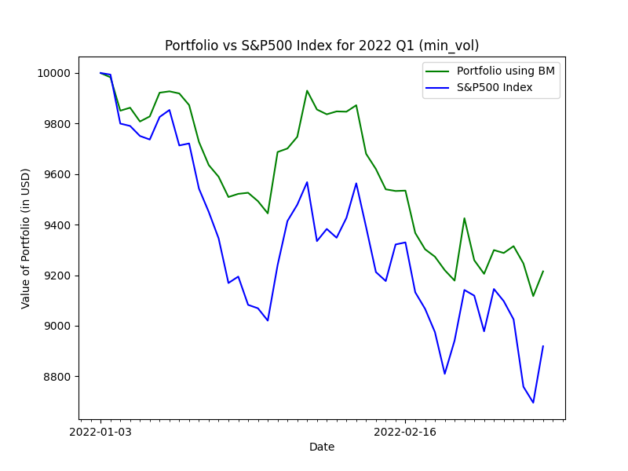
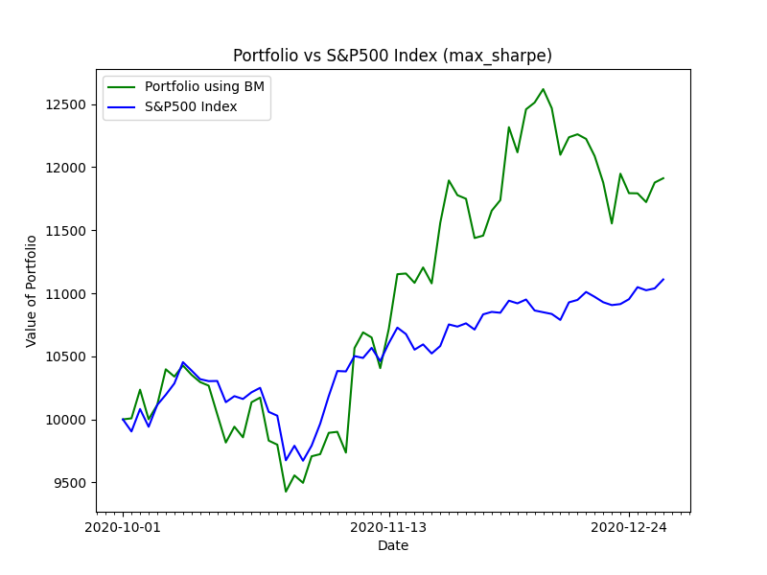

Slide 21
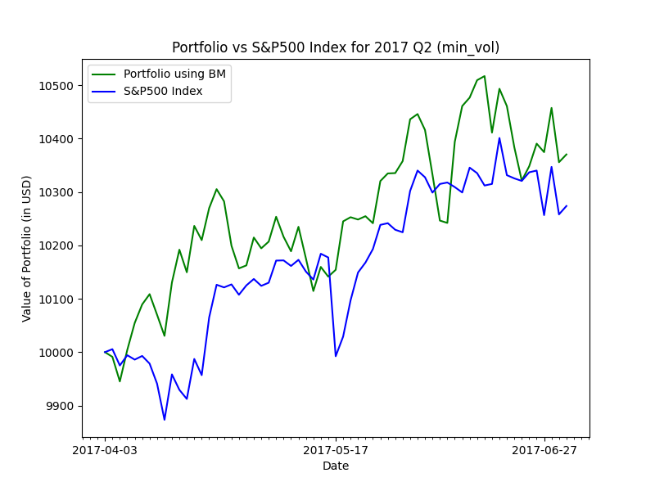
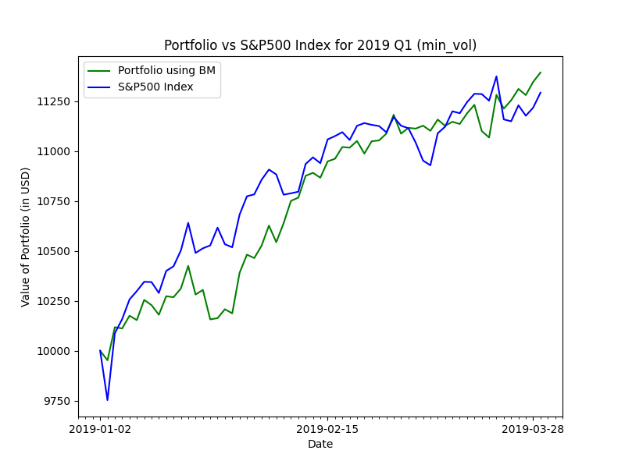
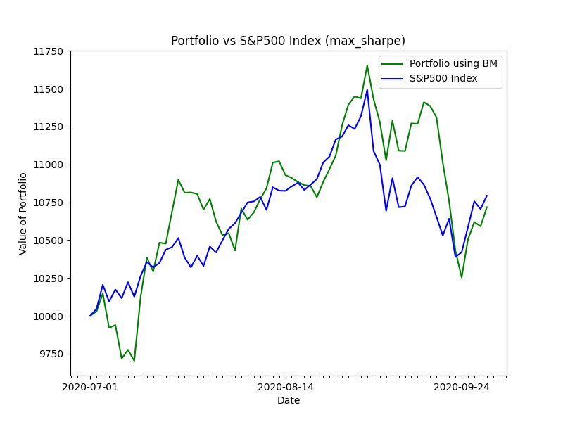
Follows the index

Slide 22
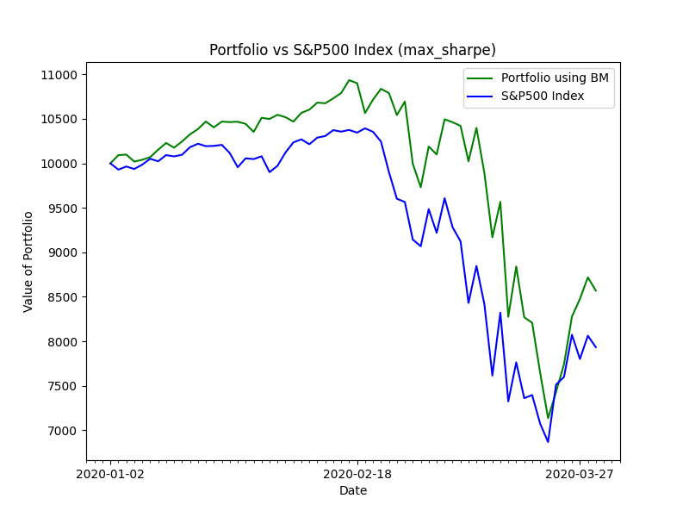
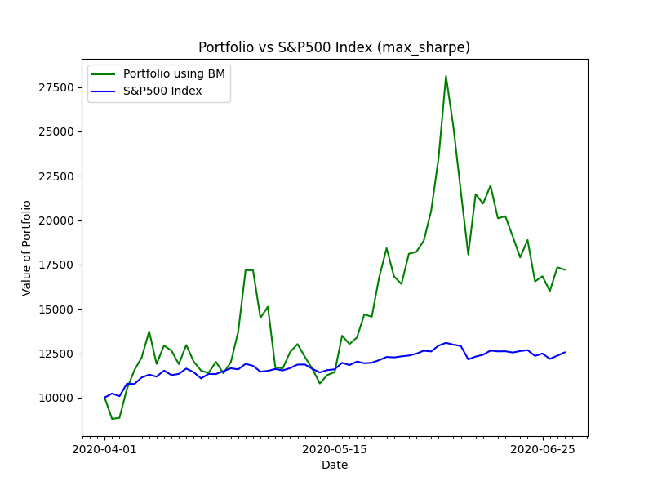
Beginning of Covid 19

Slide 23
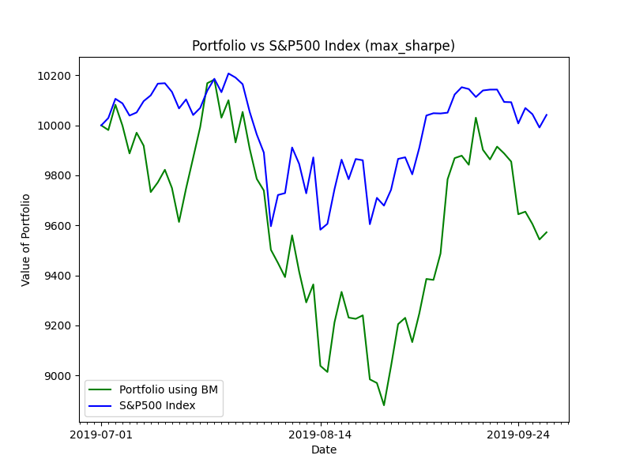
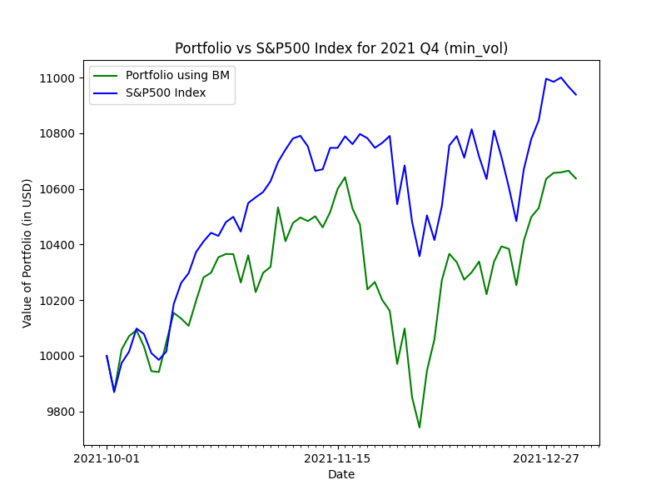
Fails

Slide 24
Future Work
Currently, we have used Return to Asset and Debt to Assets ratio for refining using Ball Mapper Algorithm. We can explore other similar company fundamental ratios like Price to Equity, Return on Equity, Quick Ratio, etc.
We can also use PCA to project high dimensional data incorporating multiple fundamental values to a lower dimension to allow proper clustering.
Compare the performance of Ball Mapper Algorithm w.r.t. general clustering algorithms like k-mean clustering.
Try out different models for portfolio selection.
We have done the testing for S&P 500 companies. We could test the model for various other markets like NIFTY 500, BSE 500, etc. Currently, this was not possible due to lack of clean data.

Slide 25
Thank you

